Slide 1
“Mendz Er" Cave
Participants: Natalie Zakaryan
Lika Poghosyan
Anna Danielyan

Slide 2
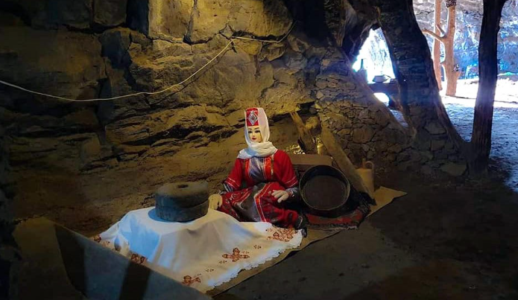
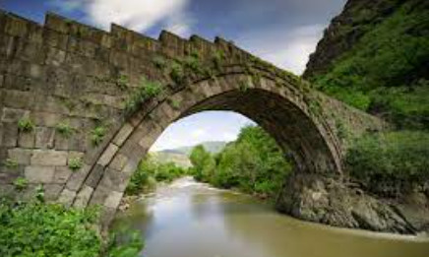
On the road leading to Sanahin-Saraart in the city of Alaverdi in Lori region, there is the cave Mendza Er. Probably, it was a prehistoric dwelling, later turned into a shelter, and not so long ago became a pen for goats. There are many caves in the Debed gorge, each of which has its own legends.

Slide 3
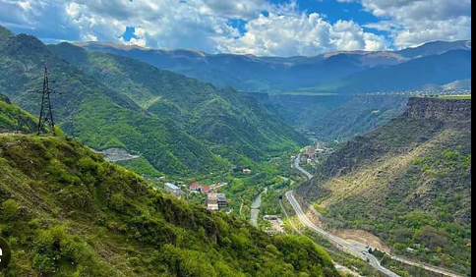
They say that the cave is very long, has a right passage, which, according to history, connected with the monastery complex of Sanahin. And indeed, the cave is located right in the mountain, with several successive caves, very close to the monasteries of Haghpat, Sanahin, Akhtala and the famous Stone Bridge.

Slide 4
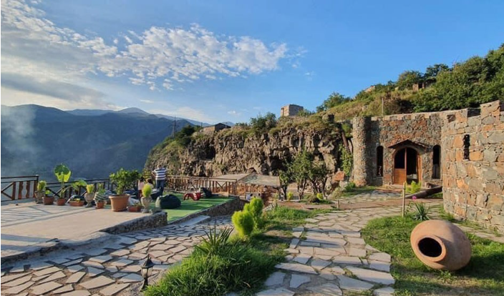
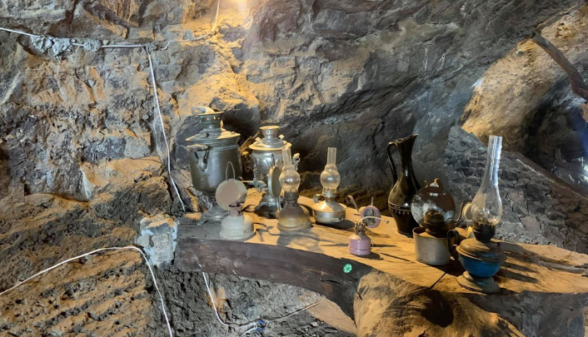
From the cave, visitors have a view of the fabulous paradise of Lori. Nature with the surrounding mountains, the majestic Mount Lalvar, valleys and groves. Below is the city of Alaverdi and the Debed River.

